Slide 1



DEFERRABLE SERVER ALGORITHM
Presented by : Kashif raza

Slide 2
MOTIVATION
Challenges addressed by Deferrable Server
Efficient Handling of Aperiodic Tasks
Maintaining Predictability in Real-Time Systems
Resource Allocation
Task Scheduling

Slide 3
INTRODUCTION
Deferrable Server
Periodic Tasks
Aperiodic Tasks

Slide 4

INTRODUCTION
Understanding deferrable server

Slide 5
DEFERRABLE SERVER
Algorithm description
Role in RTS
Scheduling in DS
Comparison with PS
Real-World Applications

Slide 6
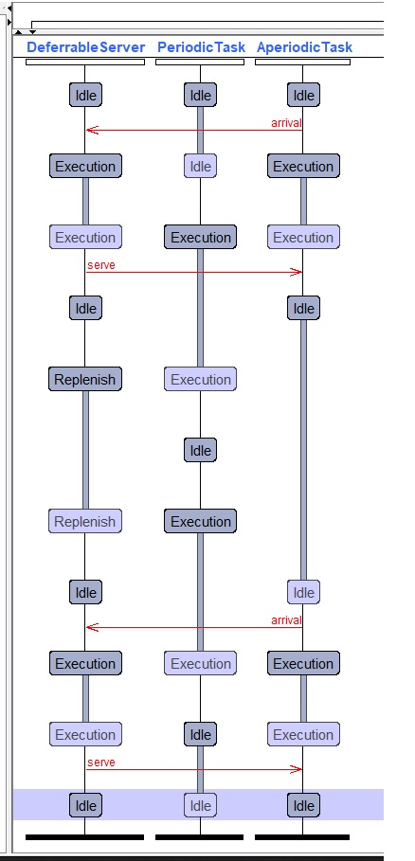
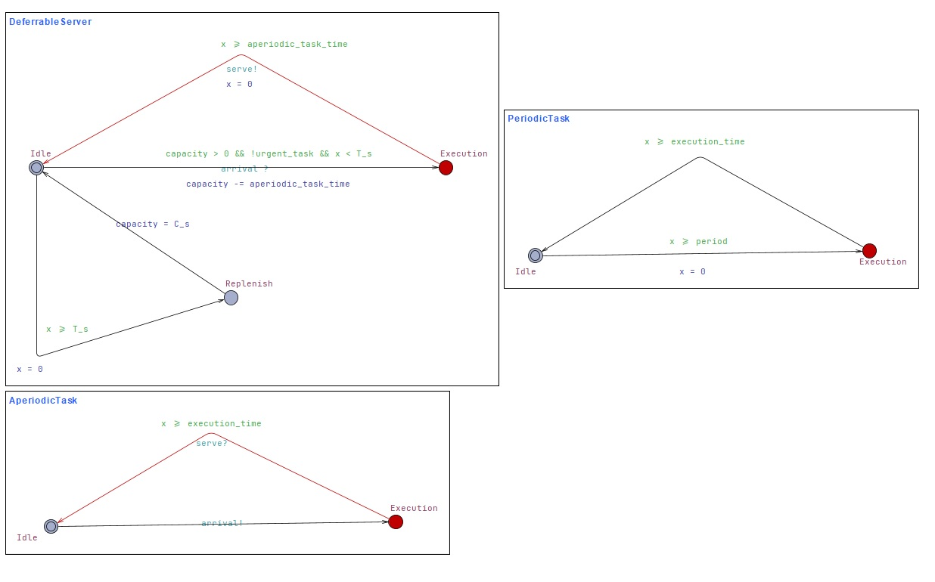
Uppaal Modelling

Slide 7
CONCULSION
Integrates aperiodic tasks
Prioritizes periodic deadlines
Efficient resource management
Enhances responsiveness
Improves system performance

Slide 8
THANKS

